Slide 1

Python Workshop
Session 2

Slide 2
Content
Modules & Libraries
Algorithmic Reasoning & Exercises
Algorithmic usage in Sorting
Real World Example

Slide 3
Modules
Def = Module is a file containing Python definitions and statements(functions, variables, classes, etc.) that can be imported into other programs
Extra detail = Most modules only use lowercase letters
Common Modules = math, random, asyncio,

Slide 4
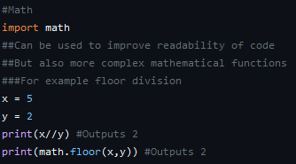
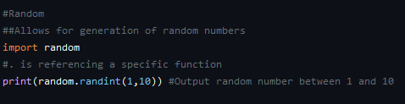
In-Built Modules Examples

Slide 5

Creating own Module

Slide 6

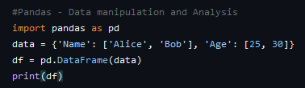
Popular Libraries
NumPy – Numerical Computing
Pandas – Data Manipulation

Slide 7
Algorithmic Reasoning
Def = An algorithm is a step-by-step process/procedure to solve a problem
Key Steps
Understand Problem (Break into manageable steps)
Design Algorithm (Plan and write pseudocode for the logic)
Implement in code (Translate logic into Python)
Test algorithm (Run with different inputs to ensure accuracy)

Slide 8
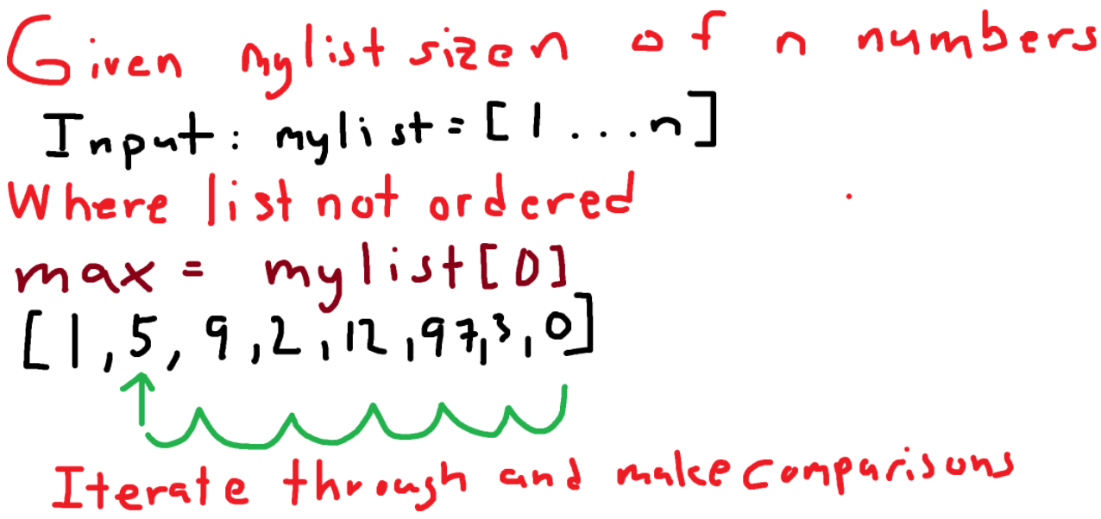
Algorithmic Exercise – Find max number

Slide 9
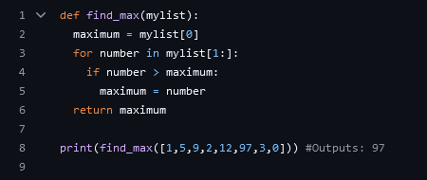
Find max number - Answer

Slide 10
Algorithm usage in Sorting
Def = Understand sorting algorithms and how they can be implemented
Common Sorting Algorithms
Bubble Sort
Repeatedly swaps adjacent elements if they are in wrong order
Average complexity = O(n^2)
Selection Sort
Selects smallest elements and places it at the beginning
Average complexity = O(n^2)

Slide 11
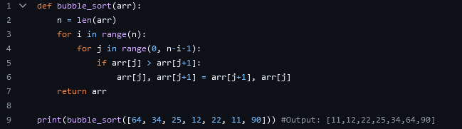
Bubble Sort Example

Slide 12
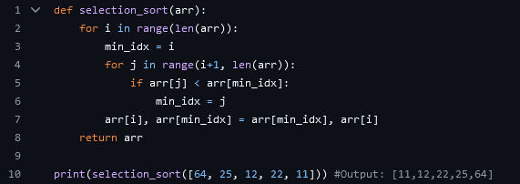
Selection Sort Example

Slide 13
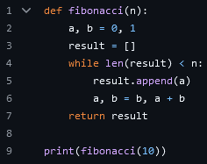
Real World Algorithm - Fibonacci

Slide 14
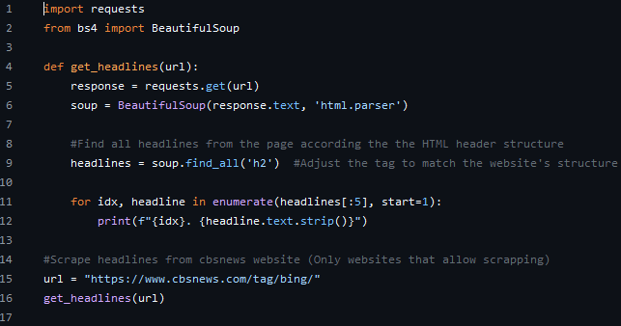
Combining Algorithms and Libraries

